Slide 1

AtliQ Hardwares
Ad Hoc business insights requests
By: João Pedro

Slide 2
Purpose
The purpose of this presentation is to show stakeholders from AtliQ Hardwares store insights from the company’s data through ad hoc analysis of their database
This will increase knowlegde to facilitate data driven business decisions
All data is available in the project’s folder on GitHub, including database SQL file and SQL queries

Slide 3
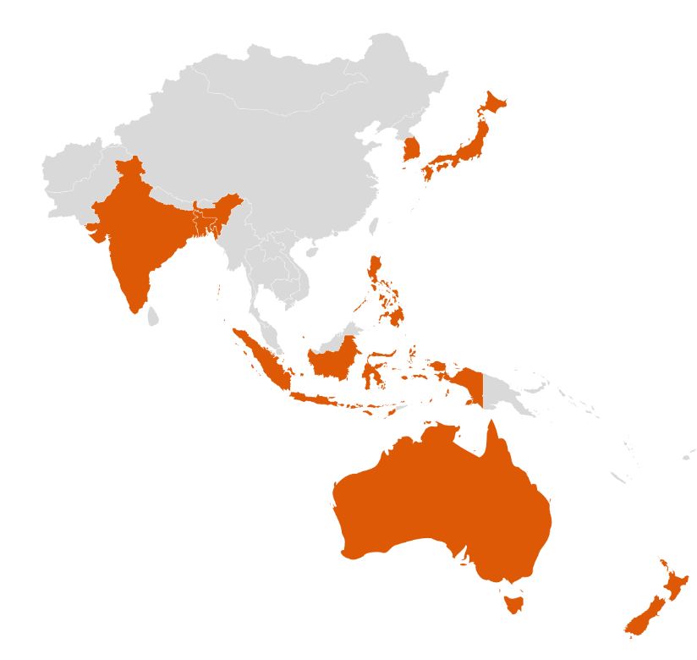
markets in which customer Atliq Exclusive operates it’s business in the APAC region.
market
Japan
India
South Korea
Indonesia
Australia
Newzealand
Philiphines
Bangladesh
AtliQ Excluse operates in 5 of the top 6 GPD countries in the APAC region (China is the only not included country)

Slide 4
What is the percentage of unique product increase in 2021 vs. 2020?
unique_products_2020 | unique_products_2021 | percentage_chg
245 | 334 | +36%

Slide 5
report with all the unique product counts for each segment and sort them in descending order of product counts
Number of unique products for each segment
segment | product_count
Notebook | 129
Accessories | 116
Peripherals | 84
Desktop | 32
Storage | 27
Networking | 9
Notebooks have the highest number of unique products, a variety of 129 products
Networking products Only have 9, the lowest variety

Slide 6
Which segment had the most increase in unique products in 2021 vs 2020?
segment | product_count_2020 | product_count_2021 | difference | percentage
Accessories | 69 | 103 | 34 | +49%
Notebook | 92 | 108 | 16 | +17%
Peripherals | 59 | 75 | 16 | +27%
Desktop | 7 | 22 | 15 | +214%
Storage | 12 | 17 | 5 | +42%
Networking | 6 | 9 | 3 | +50%
The accessories segment had the greatest increase in raw amount of product diversity
But the desktop segment had the greatest increase percentage-wise

Slide 7
Which segment had the most increase in unique products in 2021 vs 2020?

Slide 8


Products that have the highest and lowest manufacturing costs
product_code | product | manufacturing_cost
A6120110206 | AQ HOME Allin1 Gen 2 | 240,54
A2118150101 | AQ Master wired x1 Ms | 0,89

Slide 9
report which contains the top 5 customers who received an average high pre invoice discount pct for the fiscal year 2021 and in the Indian market
customer_code | customer | average_discount_percentage
90002009 | Flipkart | 30,83%
90002006 | Viveks | 30,38%
90002003 | Ezone | 30,28%
90002002 | Croma | 30,25%
90002016 | Amazon | 29,33%
The top 5 customers with highest pre invoice discount pct have around 30% discount

Slide 10
Gross sales amount for the customer Atliq Exclusive for each month
This analysis helps to get an idea of low and high-performing months and take strategic decisions
The highest gross sales amount was on November-2020: 20.463.999,00
The lowest gross sales amount was on March-2020: 378.771,00
Sales have increased due to new strategies adopted at the start of 2021 fiscal year

Slide 11
which quarter of 2020, got the maximum total sold quantity?
Quarter | total_sold_quantity
1 | 7.005.619
2 | 6.649.642
4 | 5.042.541
3 | 2.075.087
First quarter of the fiscal year of 2020 (sep, oct, nov; 2019) had the maximum sold quantity: 7.005.619 sold products

Slide 12
Which channel helped to bring more gross sales in the fiscal year 2021 and how Much it contibuted?
Channel | gross_sales_mln | percentage
Retailer | 705.532.519 | 73%
Direct | 150.664.256 | 16%
Distributor | 107.332.599 | 11%
The retail channel contributed immensely to gross sales values: 73% contribution

Slide 13
Get the Top 3 products in each division that have a high total sold quantity in the fiscal year 2021
N&S Division
division | product_code | product | total_sold_quantity | rank_order
N & S | A6720160103 | AQ Pen Drive 2 IN 1 | 701.373 | 1
N & S | A6818160202 | AQ Pen Drive DRC | 688.003 | 2
N & S | A6819160203 | AQ Pen Drive DRC | 676.245 | 3

Slide 14
Get the Top 3 products in each division that have a high total sold quantity in the fiscal year 2021
P&A Division
division | product_code | product | total_sold_quantity | rank_order
P & A | A2319150302 | AQ Gamers Ms | 428.498 | 1
P & A | A2520150501 | AQ Maxima Ms | 419.865 | 2
P & A | A2520150504 | AQ Maxima Ms | 419.471 | 3

Slide 15
Get the Top 3 products in each division that have a high total sold quantity in the fiscal year 2021
PC Division
division | product_code | product | total_sold_quantity | rank_order
PC | A4218110202 | AQ Digit | 17.434 | 1
PC | A4319110306 | AQ Velocity | 17.280 | 2
PC | A4218110208 | AQ Digit | 17.275 | 3

Slide 16
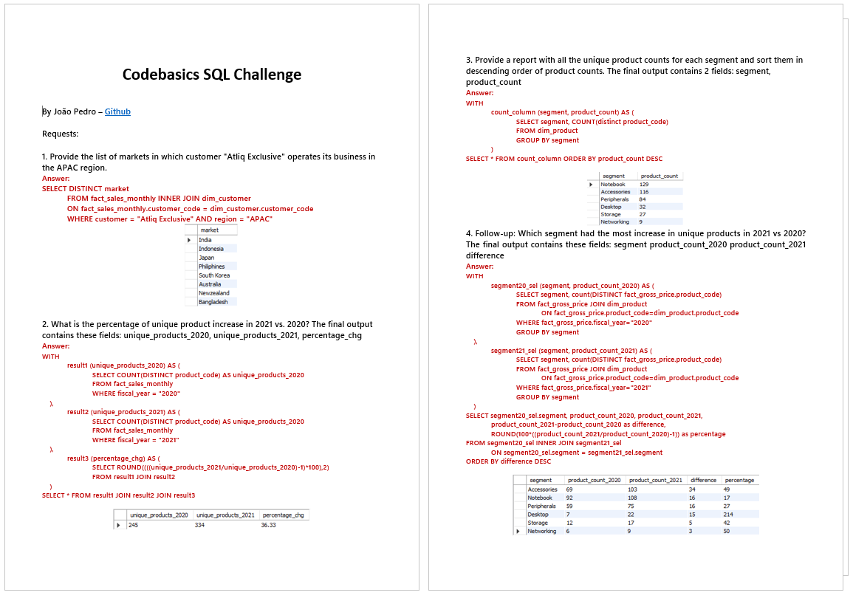
Thank you
All data is available in the project’s folder on GitHub, including database SQL file and SQL queries

